Slide 1
CARDIAC AMYLOIDOSIS
CHAIR PERSON – DR.SAM JACOB
ASST PROFESSOR
PRESENTER - DR.HARIKISHORE
SR CARDIOLOGY

Slide 2
REFERENCES
Braunwald’s Heart diseases, a textbook of Cardiovascular Medicine ,12th ed
Hurst’s The Heart,15th ed
Mohan B, Singh S, Tandon R, Batta A, Singal G, Singh G, Singh B, Goyal A, Chhabra ST, Naved K, Jain A, Wander GS. Clinical profile of patients with cardiac amyloidosis in India. Indian Heart J. 2023 Jan-Feb;75(1):73-76. doi: 10.1016/j.ihj.2022.12.006. Epub 2022 Dec 23. PMID: 36572145; PMCID: PMC9986727
Gertz M, Adams D, Ando Y, Beirão JM, Bokhari S, Coelho T, Comenzo RL, Damy T, Dorbala S, Drachman BM, Fontana M, Gillmore JD, Grogan M, Hawkins PN, Lousada I, Kristen AV, Ruberg FL, Suhr OB, Maurer MS, Nativi-Nicolau J, Quarta CC, Rapezzi C, Witteles R, Merlini G. Avoiding misdiagnosis: expert consensus recommendations for the suspicion and diagnosis of transthyretin amyloidosis for the general practitioner. BMC Fam Pract. 2020 Sep 23;21(1):198. doi: 10.1186/s12875-020-01252-4. PMID: 32967612; PMCID: PMC7513485.

Slide 3
Falk RH, Alexander KM, Liao R, Dorbala S. AL (Light-Chain) Cardiac Amyloidosis: A Review of Diagnosis and Therapy. J Am Coll Cardiol. 2016 Sep 20;68(12):1323-41. doi: 10.1016/j.jacc.2016.06.053. PMID: 27634125.
Hartnett J, Jaber W, Maurer M, Sperry B, Hanna M, Collier P, Patel DR, Wazni OM, Donnellan E. Electrophysiological Manifestations of Cardiac Amyloidosis: JACC: CardioOncology State-of-the-Art Review. JACC CardioOncol. 2021 Oct 19;3(4):506-515
Dorbala S, Ando Y, Bokhari S, Dispenzieri A, Falk RH, Ferrari VA, Fontana M, Gheysens O, Gillmore JD, Glaudemans AWJM, Hanna MA, Hazenberg BPC, Kristen AV, Kwong RY, Maurer MS, Merlini G, Miller EJ, Moon JC, Murthy VL, Quarta CC, Rapezzi C, Ruberg FL, Shah SJ, Slart RHJA, Verberne HJ, Bourque JM. ASNC/AHA/ASE/EANM/HFSA/ISA/SCMR/SNMMI expert consensus recommendations for multimodality imaging in cardiac amyloidosis: Part 1 of 2-evidence base and standardized methods of imaging. J Nucl Cardiol. 2019
Ruberg, F, Grogan, M, Hanna, M. et al. Transthyretin Amyloid Cardiomyopathy: JACC State-of-the-Art Review. J Am Coll Cardiol. 2019 Jun, 73 (22) 2872–2891.
Donnelly, Joseph P and Mazen Hanna. “Cardiac amyloidosis: An update on diagnosis and treatment.” Cleveland Clinic Journal of Medicine 84 (2017): 12 - 26.

Slide 4
TOPICS
NOMENCLATURE
EPIDEMIOLOGY
PATHOBIOLOGY
CLINICAL FEATURES
DIAGNOSIS
TREATMENT

Slide 5
NOMENCLATURE

Slide 6
AMYLOID- name derived from latin ‘amylum’ (starch)
RUDOLF VIRCHOW- FATHER OF MODERN pATHOLOGY, 1854
‘A’ for Amyloid, followed by precursor protein abbreviation

Slide 7
What is Cardiac Amyloidosis?
Cardiac amyloidosis
A disorder caused by deposits of an abnormal protein (amyloid) in the heart tissue.
These deposits make it hard for the heart to work properly.
Alternative Names
Amyloidosis – cardiac
Primary cardiac amyloidosis - AL type
Secondary cardiac amyloidosis - AA type
Stiff heart syndrome; Senile amyloidosis
Libby P, Bonow RO, Mann DL, Tomaselli GF, Bhatt DL, Solomon SD, eds. Braunwald's Heart Disease: A Textbook of Cardiovascular Medicine. 12th ed. Philadelphia, PA: Elsevier; 2022:chap 52.

Slide 8
EPIDEMIOLOGY

Slide 9
AL amyloidosis
4,000 new cases/year.
1 per every 64500 adults.
Hereditary ATTR amyloidosis
V122I allele-4% in Black people of West African descent
Highest in Portuguese 1/538 people
Wild-type ATTR amyloidosis
20% in male over 80 years of age
Dialysis-related amyloidosis.
20% of those on dialysis for 2-4 years.
In every patients on dialysis more than 12 years.
AD, Age dependent clinical penetrance (>65 years), 50,000- 1,00,000 possible cases
Possible 10-15% over 60 years with HFpEF
~10% with severe AS
>1,00,000 likely cases in US
Libby P, Bonow RO, Mann DL, Tomaselli GF, Bhatt DL, Solomon SD, eds. Braunwald's Heart Disease: A Textbook of Cardiovascular Medicine. 12th ed. Philadelphia, PA: Elsevier; 2022:chap 52.

Slide 10
What are the numbers in India?
Limited data exists on patients with cardiac amyloidosis (CA) in India, due to under-diagnosis and late presentation.
Single centre data from 13 patients over a 4 year period with a median age of 65 years
At the end of the follow up period, 46% patients died, with 30% of the overall cohort dead within six months.
Among the survivors, 71% continue to have NYHA grade III/IV symptoms.
Mohan B, Singh S, Tandon R et al, Indian Heart J. 2023 Jan-Feb;75(1):73-76

Slide 11
Medical records were screened starting from 1987 up to 2019 and patients with histopathological diagnosis of CA were identified
40 patients were enrolled, out of which 26 (65%) were males
Median age at presentation was 51 years with a range of 33–65 years
Median survival from diagnosis was 2.1 years
Journal of the Practice of Cardiovascular Sciences 7(2):p 121-127, May–Aug 2021.

Slide 12
PATHOBIOLOGY

Slide 13
AMYLOIDOSIS
AL Amyloidosis
ATTR Amyloidosis
Protein : Immunoglobulin light chain
Protein factory: Plasma cells in bone marrow
Protein: Transthyretin
Protein factory: Liver
Notes:
Transthyretin also produced in choroid plexus & retina. It is a transport protein for thyroxine & retinol (vitamin-A)

Slide 14
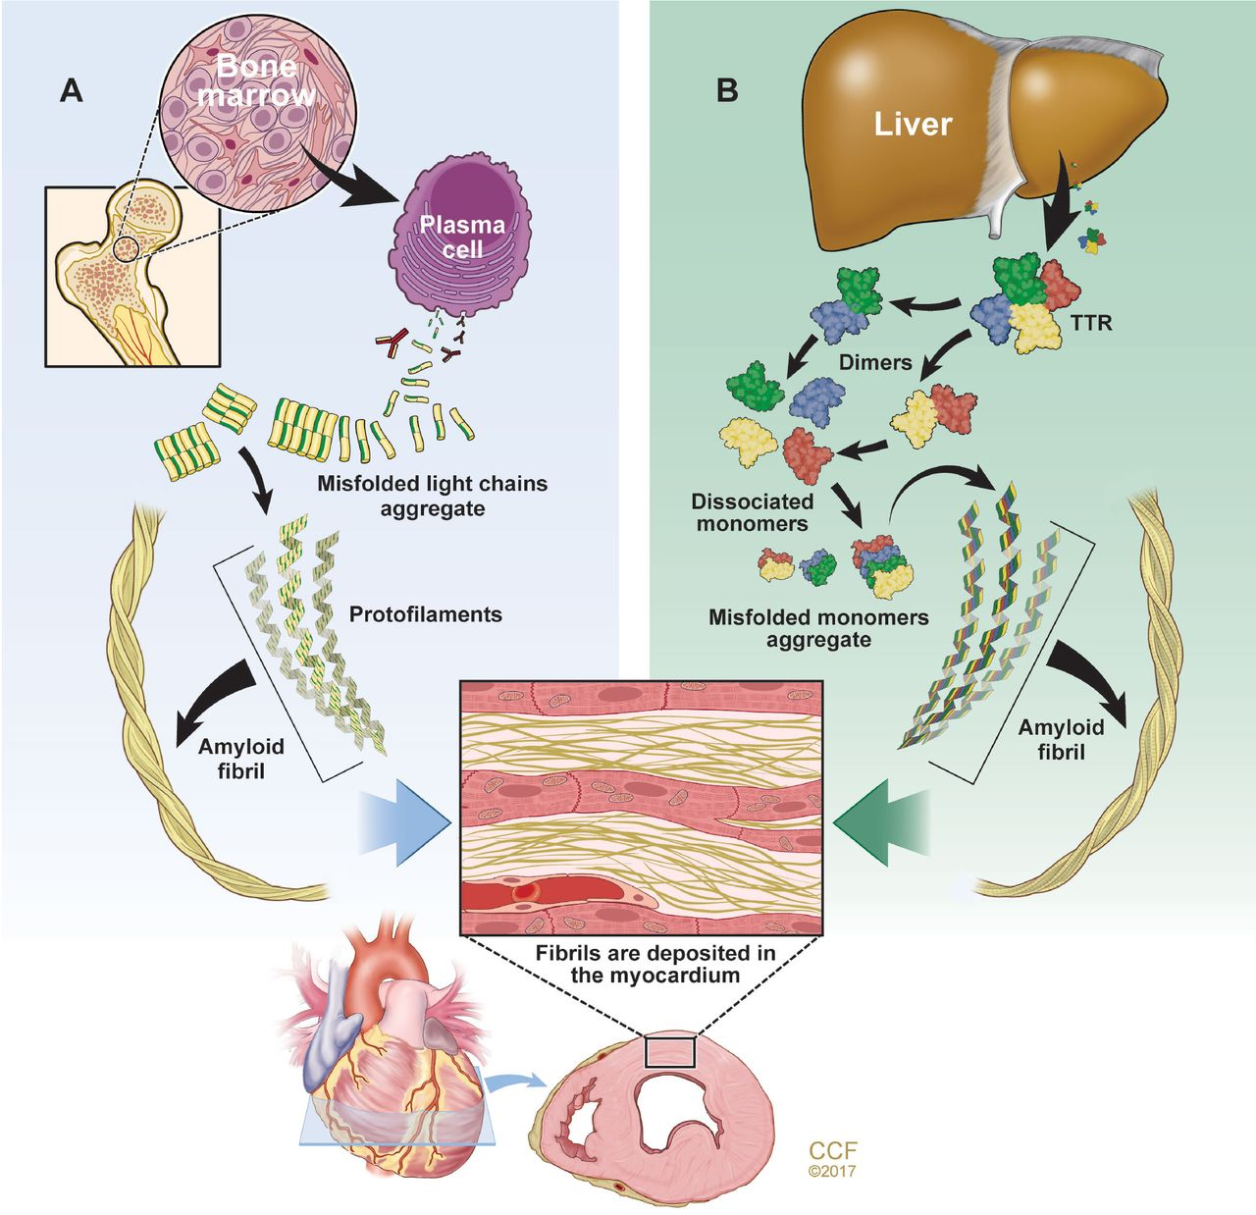
AL AMYLOIDOSIS
ATTR AMYLOIDOSIS
Notes:
MC organ affected by AL amyloidosis is Heart

Slide 15
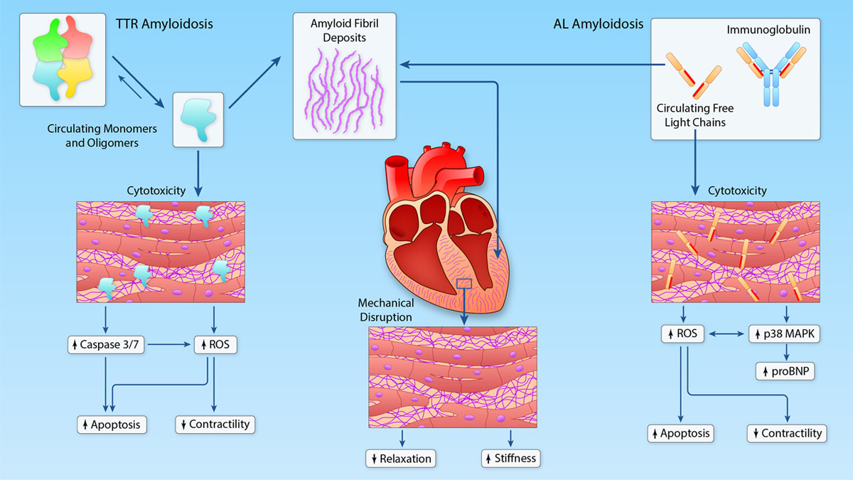

Slide 16
How does this condition affect heart?
amyloid proteins build up in heart muscle
Thickening of heart wall – heart enlargement
Heart has to work extra leading to heart failure
Thickening of heart walls.
Cardiac amyloidosis
irregular heart rhythms (arrhythmias)/weaken heart’s electric current
Atrial fibrillation
Disruptions in your heart’s electrical system
Amyloid proteins
waxy, stick together easily and form large clusters
get stuck in a heart valve
partially block the valve and limit blood flow
Amyloid buildup
Libby P, Bonow RO, Mann DL, Tomaselli GF, Bhatt DL, Solomon SD, eds. Braunwald's Heart Disease: A Textbook of Cardiovascular Medicine. 12th ed. Philadelphia, PA: Elsevier; 2022:chap 52.

Slide 17
CLINICAL FEATURES

Slide 18
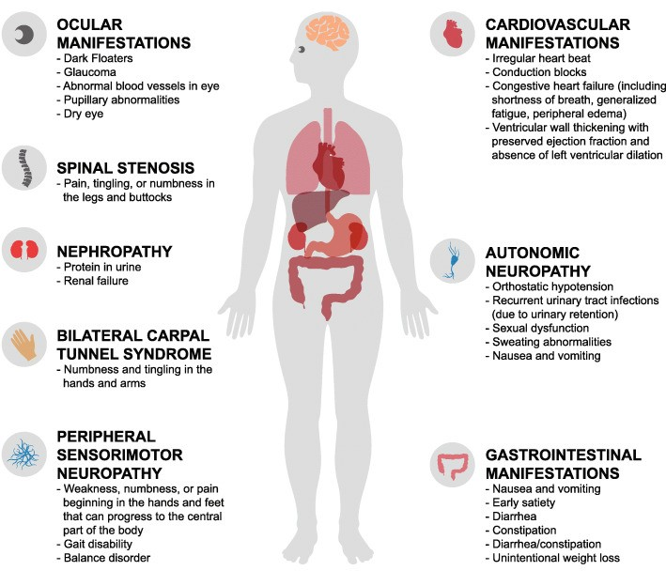
ATTR
Gertz M, BMC Fam Pract. 2020
Notes:
Carpel Tunnel Syndrome- this can be an early warning sign 7 -8 years before this condition otherwise becomes apparent

Slide 19
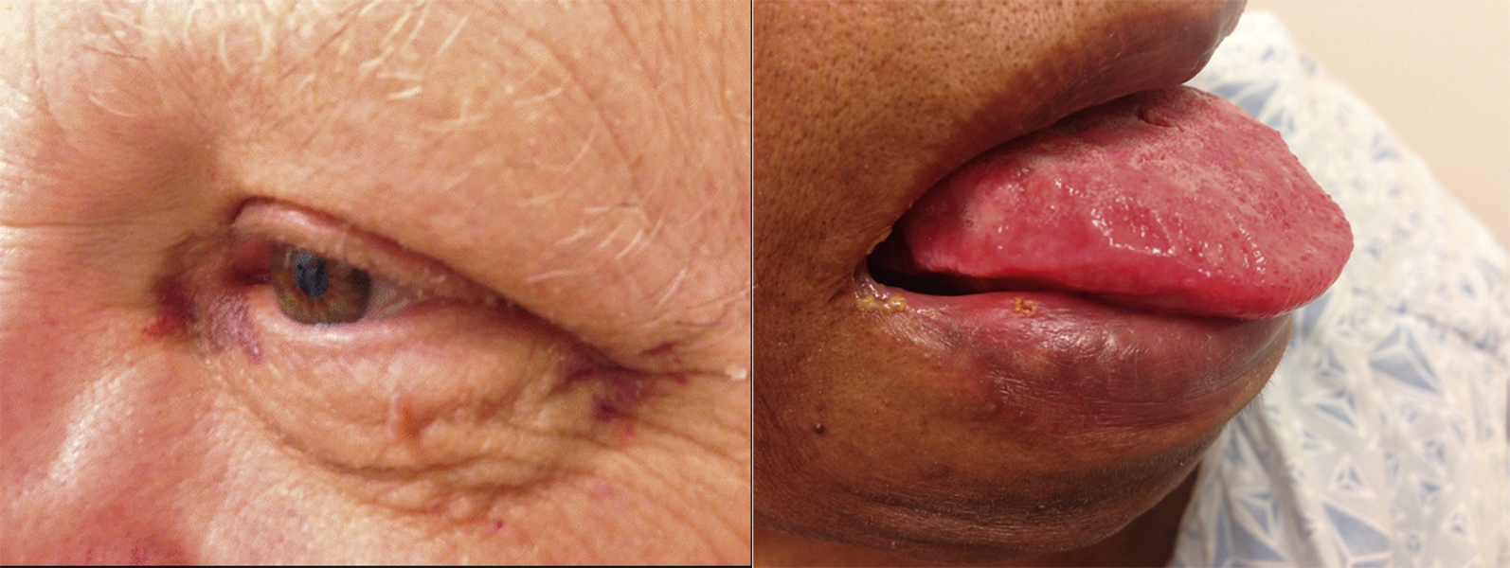
AL
PATHOGNOMIC
10%
Falk, Jacc 2016, Sep, 68 (12) 1323–1341

Slide 20
OTHER CLINICAL FINDINGS
BP- Frequently Low, Postural hypotension
JVP- inspiratory rise (Kussmaul sign), Prominent V waves may be seen in the pulmonary capillary wedge tracings in the absence of significant mitral regurgitation
HEART SOUND- 4th heart sound > 3rd heart sound
ATRIAL ARRYTHMIA- Initial manifestation (all except AL amyloidosis)
VALVULAR DYSFUNCTION - rarely severe, although on occasion, tricuspid regurgitation can be severe
HEPATOMEGALY- Soft (Congestive), Hard (Infiltrative)
Falk, Jacc 2016, Sep, 68 (12) 1323–1341
Notes:
The blood pressure in suspected cardiac amyloidosis is frequently low, due to a combination of reduced cardiac output and low peripheral tone. It should always be measured both supine and standing, because autonomic nervous system dysfunction may manifest as significant postural hypotension.

Slide 21
ELECTROPHYSIOLOGIC MANIFESTATION
Hartnett J et al JACC CardioOncol. 2021

Slide 22
1. AF- 70% (MC)
2. AV Nodal disease:
1st deg AV block (MC), High Grade AV block
QRS ≥120 ms – elevated risk of AV block
Pacemaker requirement : ATTRwt-CA > ATTRv-CA >AL-CA
BV pacing > single chamber (RV pacing)
3. VENTRICULAR ARRYTHMIAS:
Mechanism:
patchy amyloid fibril infiltration within the ventricular myocardium along with microvascular
ischemia leading to the development of anatomical re-entrant circuits
amyloid cytotoxicity to ventricular myocardial cells
AL-CA > ATTR-CA
4. SINUS NODE DYSFUNCTION (Un common)
Hartnett J et al JACC CardioOncol. 2021
Notes:
1.Progression of conduction system disease is common and often leads to increased right ventricular (RV) pacing burden with time
2.Despite the high prevalence of conduction disease in CA and the predisposition
for amyloid to deposit in the atria, SND in CA is not well studied

Slide 23
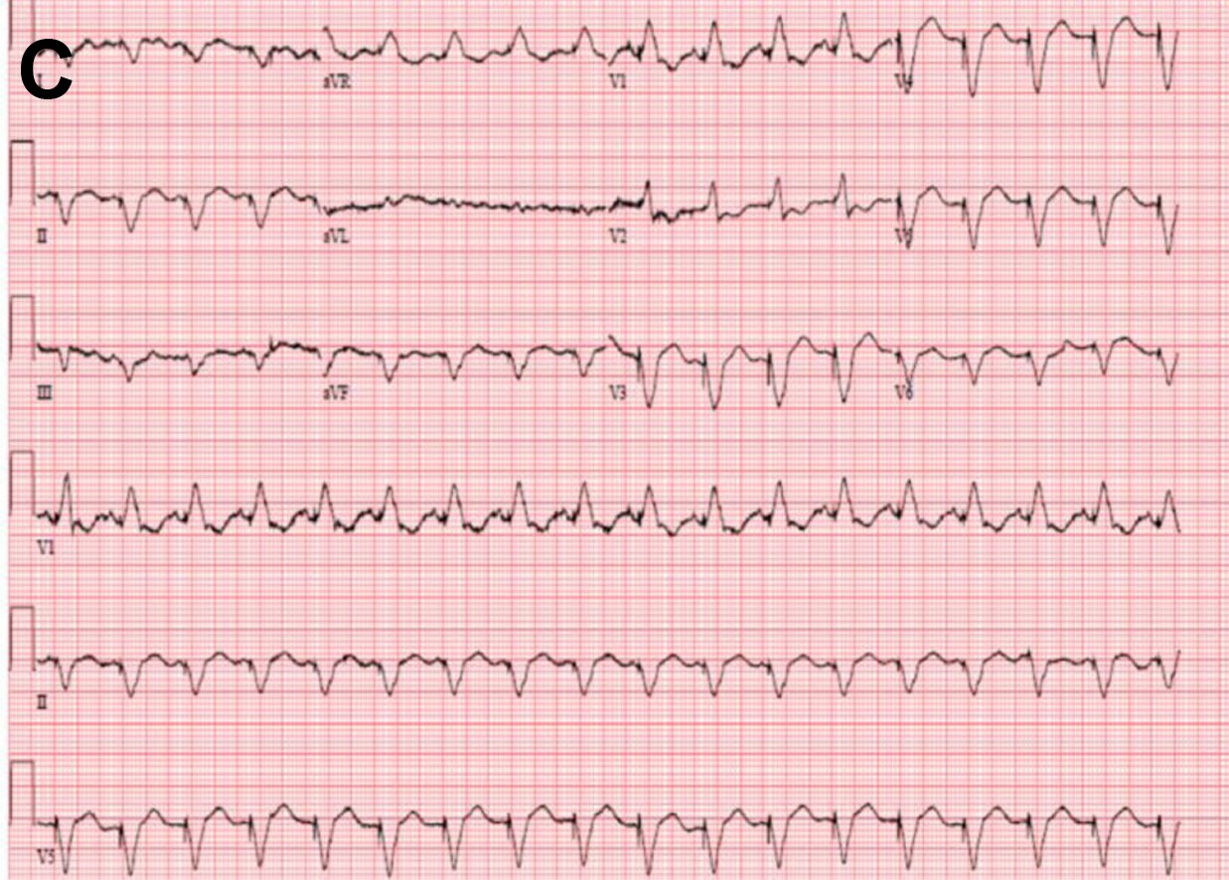
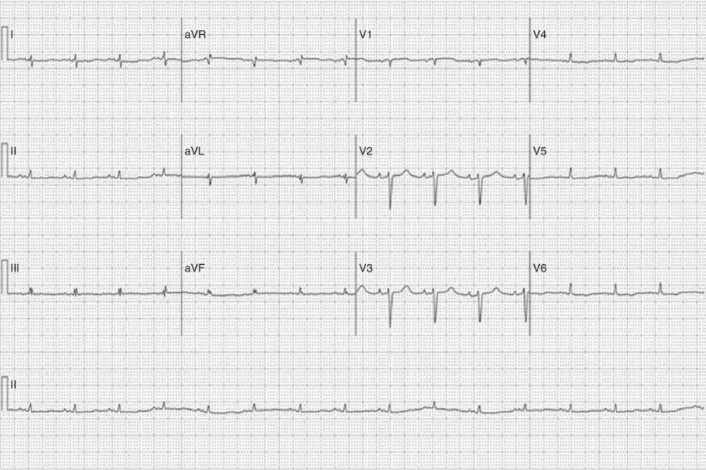
D
Notes:
(A) atrial Fibrillation, (B) right ventricular apical pacing, and (C)biventricular pacing (D) low voltage and pseudo-infarct pattern

Slide 24
DIAGNOSIS

Slide 25
QUICK TIP:
ENDOMYOCARDIAL BIOPSY (GOLD STANDARD)- Not necessary
ECHOCARDIOGRAPHY WITH STRAIN IMAGING & CARDIOVASCULAR MAGNETIC RESONANCE (CMR) can identify patterns strongly suggestive of CA
Nuclear imaging with bone-seeking tracers (PYP & DPD&HMDP)- ATTR amyloidosis & no evidence of a plasma cell disorder by blood or urine testing
Genotyping of TTR is essential in cases of confirmed ATTR
Notes:
Technetium-based compounds (pyrophosphate [Tc-PYP], diphosphono-1,2-propanodicarboxylic acid [Tc-DPD], and hydroxymethylene diphosphonate [Tc-HMDP])

Slide 26
LAB TESTING:
BNP or NT-pro-BNP
Troponin I or Troponin T
Prealbumin (TTR)
Serum free light chains (kappa & lambda)
Serum immunofixation electrophoresis
Renal function panel

Slide 27
ENDOMYOCARDIAL BIOPSY
100% sensitive & specific
biopsy specimens are collected from multiple sites (≥4 are recommended)
Notes:
(A) Autopsy specimen reveals biventricular thickening, biatrial dilatation, and thickening of both mitral and tricuspid valves. (B) Hemotoxylin and eosin staining showing diffuse amyloid deposition. (C) Characteristic apple green birefringence on polarized light microscopy. (D) Immunohistochemistry for typing of amyloid. Mass spectrometry (not illustrated) can also be performed for typing and is considered the gold standard.

Slide 28
ECHO:
Notes:
(a) (parasternal long axis) and (b) (parasternal short axis) demonstrate increased LV wall thickness with a sparkling texture of the myocardium (yellow arrows) in a patient with primary (AL) cardiac amyloidosis. Also, note the small pericardial effusion (white arrows), which is often seen in patients with cardiac amyloidosis. (c) (apical 4-chamber view) demonstrates increased biventricular wall thickness, biatrial enlargement, and increased thickening of the interatrial septum (yellow arrow) and mitral valve leaflets (white arrow) in a patient with wild-type transthyretin cardiac amyloidosis.
(d) Tissue Doppler imaging (TDI) tracing taken at the septal mitral annulus in a patient with ATTR cardiac amyloidosis. The TDI tracings shows the “5-5-5” sign (s’ [systolic], e’ [early diastolic], and a’ [late (atrial) diastolic] tissue velocities are all < 5 cm/s), which is seen in patients with more advanced cardiac amyloidosis. The dotted lines denote the 5 cm/s cut-off for systolic and diastolic tissue velocities. In addition to the decreased tissue velocities, isovolumic contraction and relaxation times (IVCT and IVRT, respectively) are increased and ejection time (ET) is decreased, findings also seen in patients with cardiac amyloidosis especially as the disease becomes more advanced, normal : IVRT – 94 ms, IVCT-36 , ET-286

Slide 29
SPECKLE TRACKING ECHOCARDIOGRAPHY
Notes:
(a) (apical 4-chamber view), all show abnormal longitudinal strain in the basal and mid segments with relative preservation in the apical segments (purple and green curves, white arrows) in a patient with ATTRv cardiac amyloidosis. (b) shows the corresponding bullseye map of the longitudinal strain pattern throughout the left ventricle with the “cherry-on-the-top” sign (red denotes normal longitudinal strain at the apex and pink/blue denotes abnormal longitudinal strain at the mid/basal left ventricle)

Slide 30
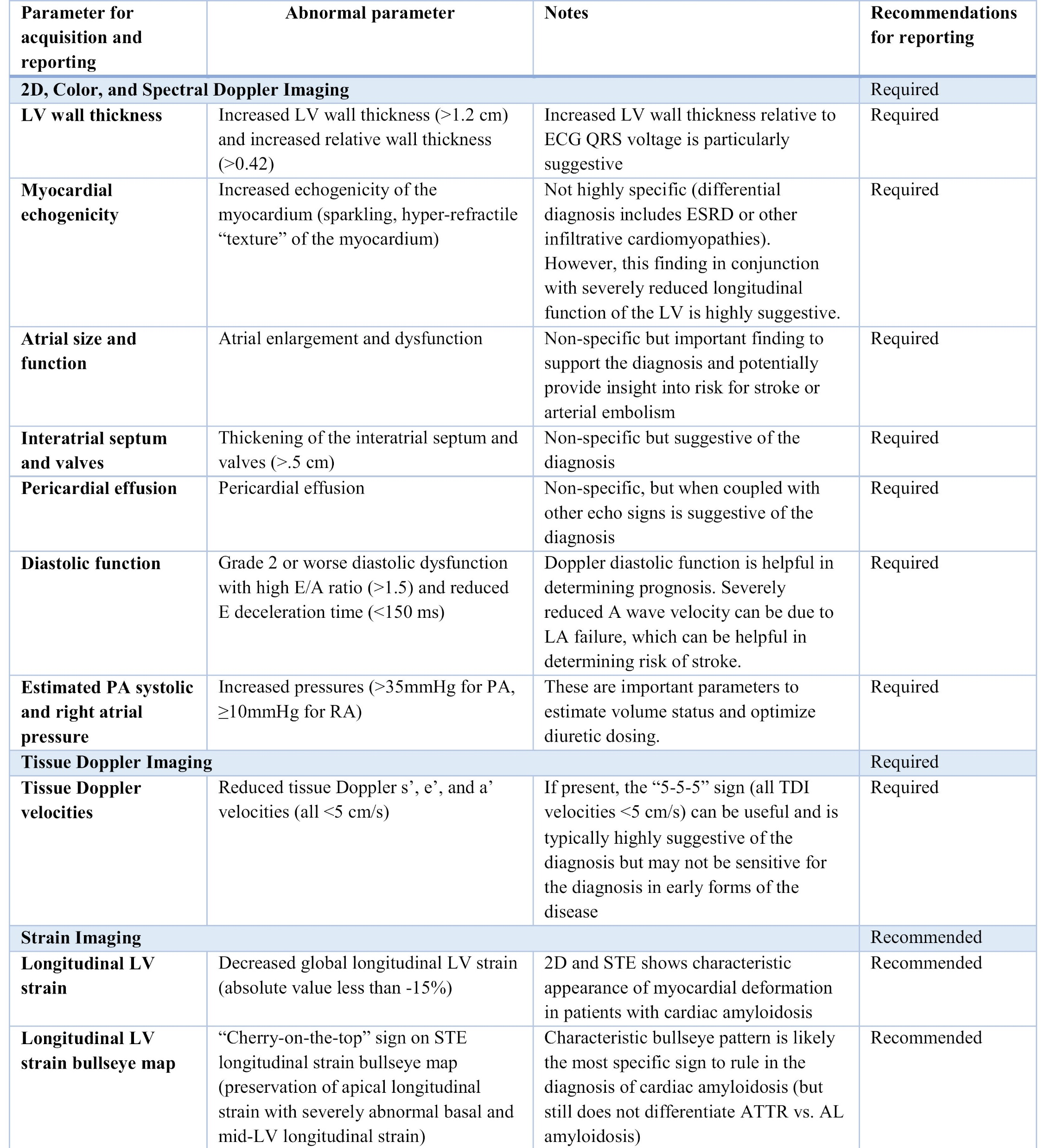
Dorbala S et al J Nucl Cardiol. 2019

Slide 32
Dorbala S et al J Nucl Cardiol. 2019

Slide 33
CMR
Notes:
Images shown include 4-chamber cine, corresponding LGE image with phase-sensitive reconstruction, native T1 maps, and extracellular volume (ECV) maps in 3 patients with cardiac transthyretin amyloidosis. The patient with no LGE has normal native T1 and ECV maps; the patient with subendocardial LGE had borderline T1 values and high ECV values; and in the patient with transmural LGE, very high native T1 values and very high ECV values were seen

Slide 34
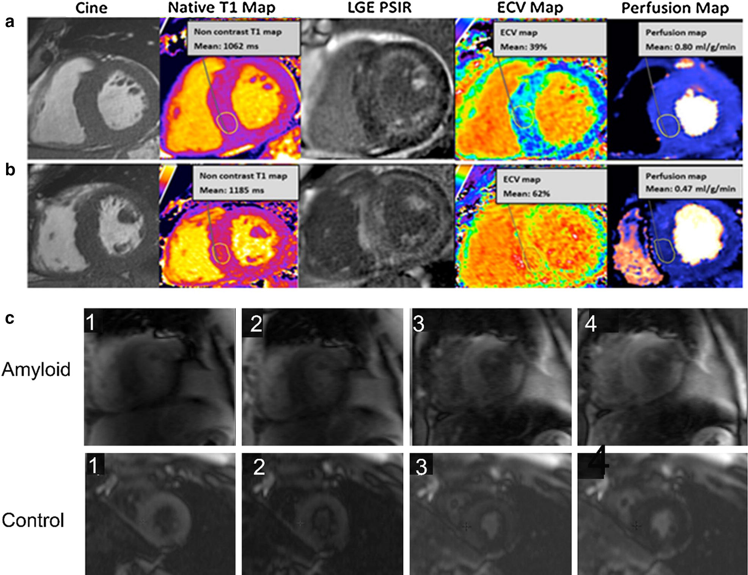
Notes:
Two patients [upper and lower row, (a) and (b)] with cardiac amyloidosis: similar mass (cine), but significantly different amyloid burden, with the patient at the bottom (b) showing a significant higher amyloid burden (higher native T1, higher ECV, transmural LGE) and lower myocardial resting perfusion (also, after adjusting for ECV expansion). (c) Inversion scout images in two patients, upper row amyloid, lower row non-amyloid control. These images show a distinct pattern of myocardial and blood pool nulling. In the non-amyloid subject, the blood pool nulls prior to myocardium; in contrast, in the subject with cardiac amyloidosis, the myocardium nulls prior to the blood pool

Slide 36
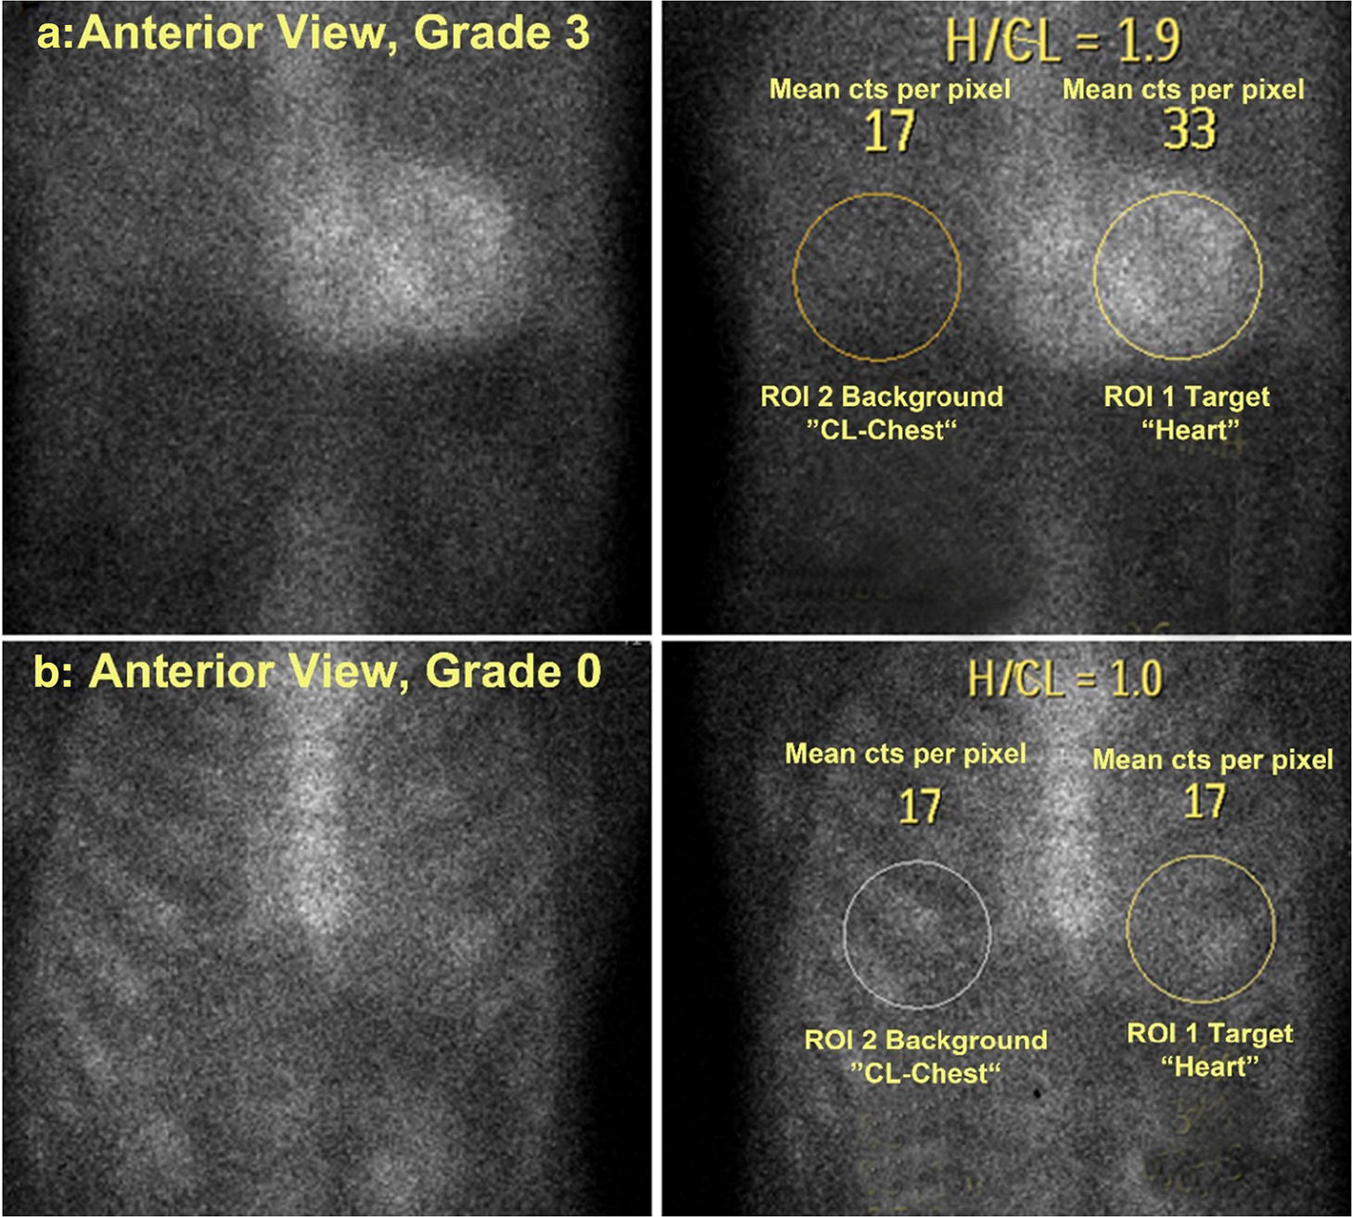
^{99m}Tc-PYP/DPD/HMDP imaging
^{99m}
Notes:
Anterior planar chest views one hour after injection of 99mTc-PYP a patient with Grade 3 (a), and Grade 0 (b) 99mTc-PYP uptake. On the right are the corresponding H/CL (heart/contralateral lung) lung-ratio methodology with measurement of mean counts per pixel for target (heart) and background (contralateral chest). As shown in this figure, the ROI’s (region of interest) should be positioned to minimize overlap with sternal or focal rib uptake and maximize coverage of the heart without including adjacent lung

Slide 37
Perugini grading scale
GRADING | INTERPRETATION
0 | No myocardial uptake & normal bone uptake
1 | Myocardial uptake less than rib uptake
2 | Myocardial uptake equal to rib uptake
3 | Myocardial uptake greater than rib uptake with mild or absent rib uptake

Slide 38
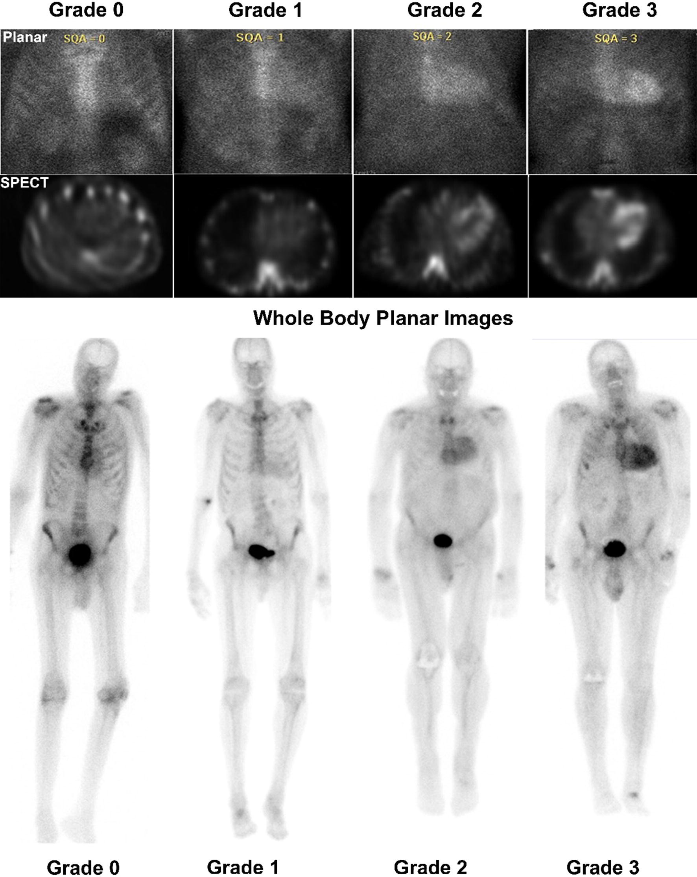
Notes:
Anterior planar chest images (Top row), SPECT cardiac imaging (Middle row) and planar whole-body imaging (Bottom row). Cardiac uptake is visually compared with surrounding ribs for a visual grading score as described in Table 5. Images with Grade 0, Grade 1, Grade 2, and Grade 3 myocardial uptake of 99mTc-PYP are shown.

Slide 39
1 HR APPROACH - H/CL ratio of ≥ 1.5 – ATTR
3 HR APPROACH - Grade 2 or 3 - ATTR
SPECT imaging - differentiate myocardial uptake from blood pool or overlying bone uptake.
Diffuse uptake - cardiac amyloidosis
Focal uptake - early cardiac amyloidosis , acute or subacute MI
ATTR CA:

Slide 40
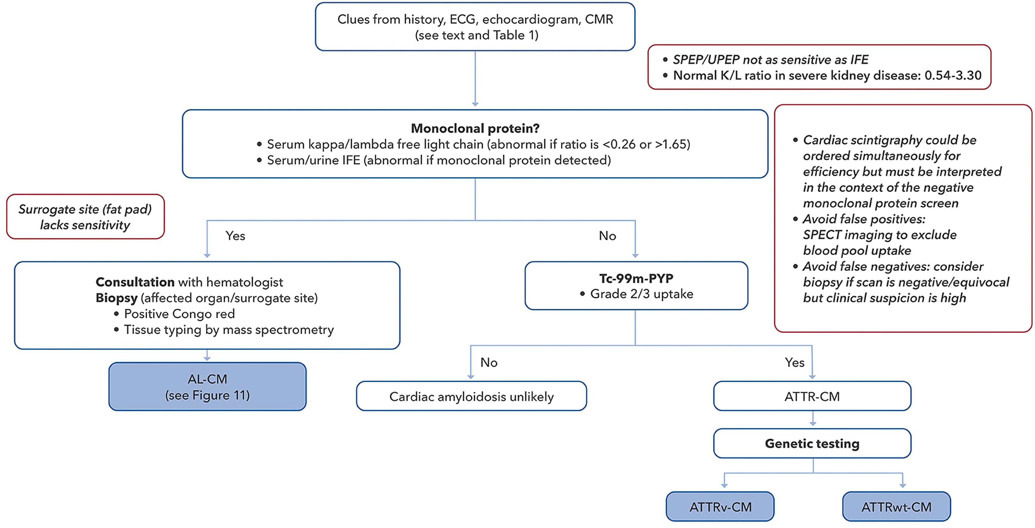
DIAGNOSTIC ALGORITHM
Kittleson, M, Ruberg, F. et al. 2023 ACC Expert Consensus Decision Pathway

Slide 41
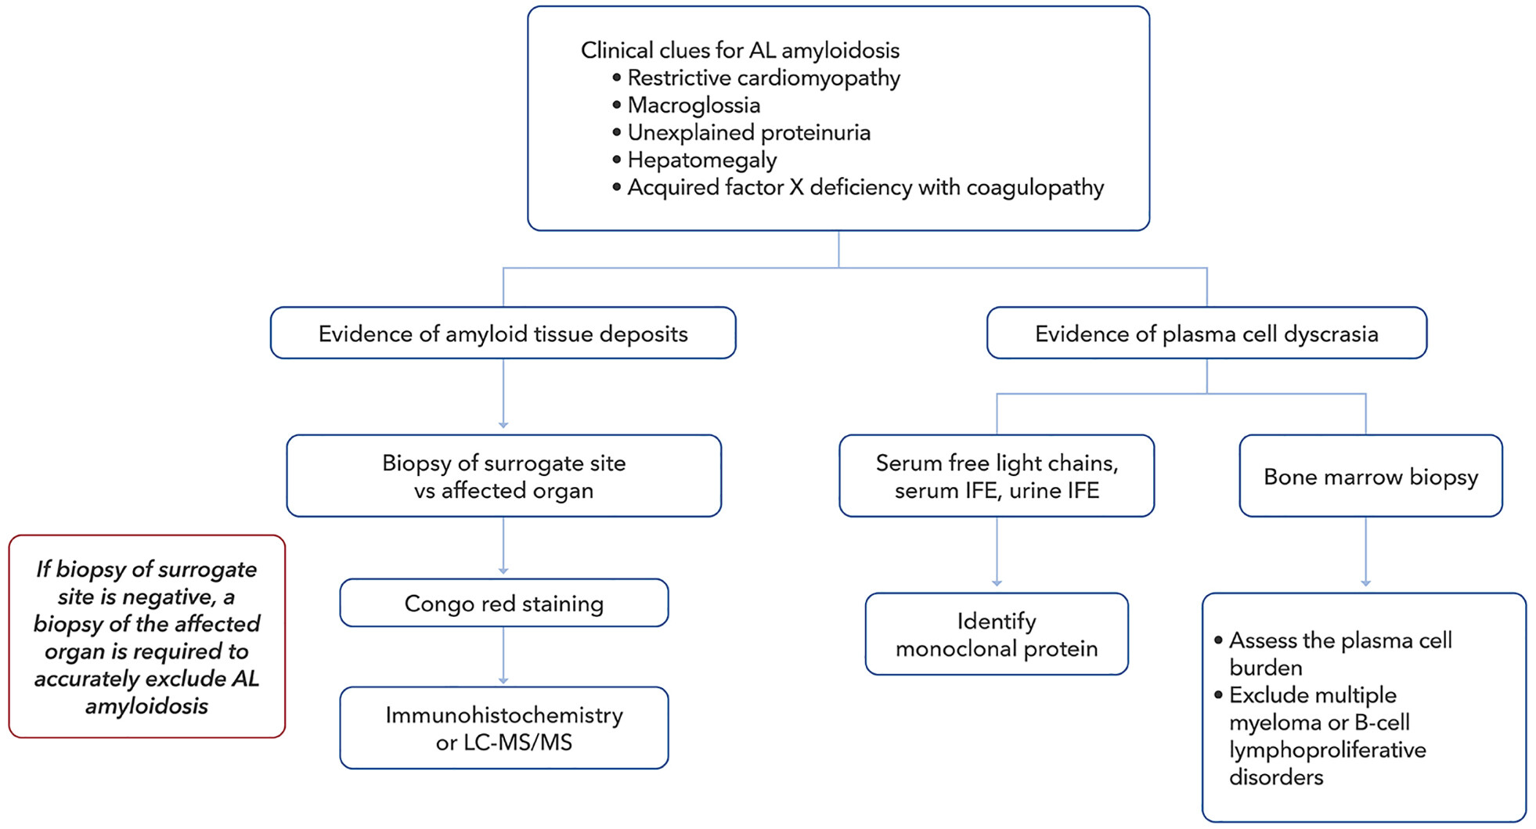
Kittleson, M, Ruberg, F. et al. 2023 ACC Expert Consensus Decision Pathway
Notes:
AL = amyloid monoclonal immunoglobulin light chain; IFE = immunofixation electrophoresis; LC-MS/MS = liquid chromatography with tandem mass spectrometry.

Slide 42
TREATMENT

Slide 43
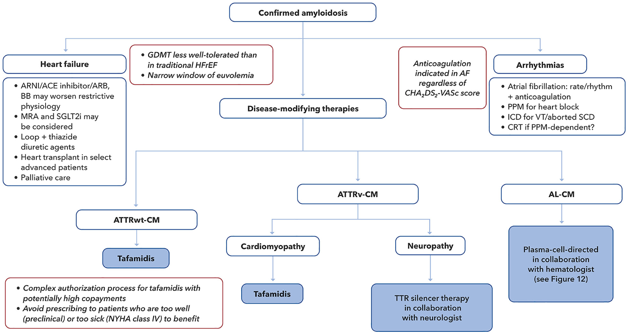

Slide 44
QUICK TIP: SYMPTOM MANAGEMENT
CHF- Loop diuretic, MRA (no guideline based recommendations for RAAS antagonists & Beta blockers)
Arrythmia is common in ATTR-CA (particularly AF) with a high rate of intra cardiac thrombi
Permanent Pacing – ATTR-CA (MC)
Role of Defibrillators- for primary prevention- not well defined
Heart transplantation- class D heart failure (outcomes similar to non-amyloid cardiomyopathy)
Notes:
BETA BLOCKERS- Physiological changes include alterations in the pressure-volume relationships with abnormal passive ventricular filling and altered ventricular-vascular coupling,76 resulting in reduced stroke volume, greater dependence on heart rate to maintain cardiac output, and inability to augment cardiac output in response to vasodilation
ARNI/ARB/ACE I- poorly tolerated due to vasodilation, particularly in patients with underlying autonomic orthostatic hypotension

Slide 45
ATRIAL FIBRILLATION
Anticoagulation- regardless of the CHA2DS2-VASc risk score
TEE- to evaluate for LAA thrombus is necessary before cardioversion, regardless of the duration of anticoagulation before the procedure
NOAC vs WARFARIN- insufficient data
Contraindication for anticoagulation- LAA closure device
Rate control- Low dose betablockade (if tolerated without hypotension)
Rhythm control- Amiodarone
Refractory AF (difficult-to-manage heart rates or tachy-brady syndrome)- AV junctional ablation with PPI

Slide 46
ARRYTHMIA
biventricular pacing has been associated with improvements in NYHA functional class, LVEF, and mitral regurgitation severity
Bradycardia and complete AV block were common prior to PEA—suggesting prophylactic pacemaker rather than ICD insertion could offer a survival benefit in patients with severe AL-CA
cardiac biomarkers (troponin and N-terminal pro–B-type natriuretic peptide) and LVEF may be inversely correlated with Ventricular arrythmia risk

Slide 47
ICD- survival benefit?
Survival is often <1 year
SCD in these patients is often caused by PEA or asystole rather than ventricular arrythmias
High defibrillation thresholds caused by amyloid infiltration within the myocardial wall

Slide 48
AMYLOID SPECIFIC THERAPY

Slide 49
QUICK TIP:
AL-CA- DARATUMUMAB- first & only FDA approved
ATTR-CA- TTR silencers or stabilizers
Selection of treatment is dependent on the phenotype (cardiac vs neurologic), (hereditary vs sporadic), cost , patient preference
Current & future clinical trials include different silencing/ stabilizing agents as well as novel approaches to facilitate degradation of amyloid deposits

Slide 50
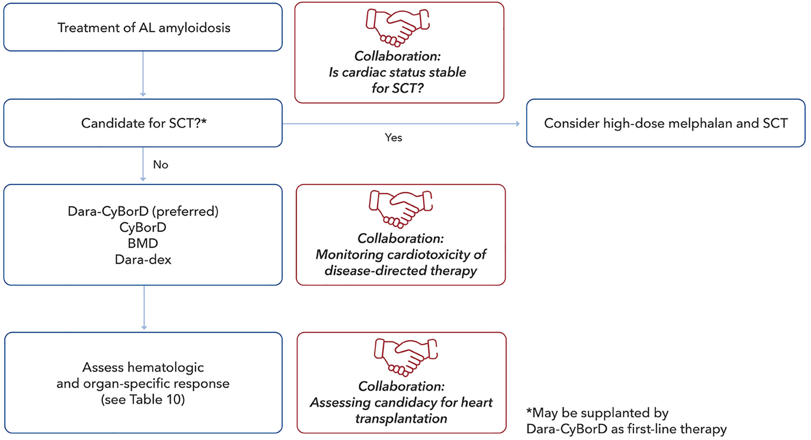
Notes:
AL = light-chain amyloidosis; BMD = bortezomib-melphalan-dexamethasone; CyBorD = cyclophosphamide, bortezomib, and dexamethasone; Dara = daratumumab; dex = dexamethasone; SCT = stem cell transplantation.

Slide 51
CARDIOTOXICITIES:
1. Bortezomib (Proteosome inhibitor)- Grade 3 HF in 6.4%, >10% decrease in LVEF in 23%
2. Cyclophosphamide:
Myocarditis, myopericarditis, pericardial effusion, including cardiac tamponade, and heart failure
Supraventricular arrhythmias (including AF and flutter) and ventricular arrhythmias (including severe QT prolongation associated with ventricular tachyarrhythmia)
Risk of cardiotoxicity may be increased with high doses of cyclophosphamide, in patients with advanced age, and in patients with previous radiation treatment to the cardiac region and/or previous or concomitant treatment with other cardiotoxic agents
3. DARATUMUMAB: (Anti CD-38)
Cardiac failure in 12%, grade 3-4 in 6%
Cardiac arrhythmia in 8%, grade 3-4 in 2%
AF in 6%, grade 3-4 in 2%
4. Melphalan- No cardiotoxicity

Slide 52
Criteria for haematologic & organ response
HAEMATOLOGIC RESPONSE: Negative SIFE & UIFE [+] Either a FLC ratio within the reference range or an uninvolved FLC concentration greater than the involved FLC concentration with or without an abnormal FLC ratio
CARDIAC RESPONSE: Decrease in NT-proBNP by >30% and <300 ng/L (if baseline NT-proBNP >650 ng/L)
RENAL RESPONSE: At least 30% decrease in proteinuria or drop below 0.5 g/24 h, in the absence of kidney progression, defined as a >25% decrease in Egfr
HEPATIC RESPONSE: 50% decrease in abnormal ALPvalue or decrease in radiographic liver size by ≥2 cm

Slide 53
TREATMENT OF ATTR-CA
ASO:
Eplontersen
SiRNA:
Vutrisiran
Patisiran
TTR Silencing/ Knock down
ASO s
siRNAs
CRISPR
TTR Stabilizers
Tafamidis
Acoramidis
Diflunisal
Anti-Amyloid
Green Tea
Doxycycline+TUDCA
Notes:
CRISPR- clustered regularly interspaced short palindromic repeat, TUDCA- tauroursodeoxycholic acid
ASO- Antisense oligonucleotide-

Slide 54
TAFAMIDIS
Delays progression of disease but will not necessarily result in its regression
FDA-approved dosages- tafamidis 61 mg or tafamidis meglumine 80 mg OD

Slide 55
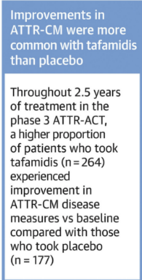
Hanna, M, JACC Adv. 2022 Dec
Notes:
KCCQ-OS = Kansas City Cardiomyopathy Questionnaire Overall Summary; PGA = patient global assessment
Pooled tafamidis cohort includes patients treated with 80 mg and 20 mg

Slide 56
PHASE 3 CLINICAL TRIALS (END POINTS)
ATTRIBUTE-CM- Acoramidis
Hierarchical combination of all-cause mortality, frequency of CV-related hospitalization, and change from baseline to month 30 of treatment in the total distance walked in 6 min
CARDIO-TTRansform- Eplontersen
Composite of CV mortality and recurrent CV clinical events up to week 140
HELIOS-B- Vutrisiran
Composite of all-cause mortality recurrent CV events (CV hospitalizations and urgent HF visits) at 30-36 months
APOLLO-B- Patisiran
6-min walk distance at 12 months
Notes:
APOLLO-B = A Study to Evaluate Patisiran in Participants With Transthyretin Amyloidosis With Cardiomyopathy; ATTRIBUTE-CM = Efficacy and Safety of AG10 in Subjects With Transthyretin Amyloid Cardiomyopathy; CARDIO-TTRansform = A Study to Evaluate the Efficacy and Safety of Eplontersen in Participants With Transthyretin-Mediated Amyloid Cardiomyopathy; CV = cardiovascular; HELIOS-B = A Study to Evaluate Vutrisiran in Patients With Transthyretin Amyloidosis With Cardiomyopathy

Slide 57
EMERGING TREATMENT OPTIONS

Slide 58
AMYLOID NEUROPATHY

Slide 59
GI AMYLOIDOSIS

Slide 60
AMYLOID NEPHROPATHY

Slide 61
ADVANCED HF

Slide 62
PROGNOSIS

Slide 63
MAYO STAGING (ATTRwt-CM)
PARAMETERS & THRESHOLD:
TnT ≤0.05 ng/ML
NT-proBNP ≤3,000 pg/mL
STAGES | No. of Parameters above threshold | Median survival (months)
1 | 0 | 66
2 | 1 | 40
3 | 2 | 20
Notes:
ATTR wild type & variant- UK staging system

Slide 64
Mayo 2004 With European Modification (AL-CM)
PARAMETERS & THRESHOLD:
TnT ≥0.035 mcg/L [OR] TnI ≥0.1 mcg/L/ [OR] High-sensitivity TnT ≥50 ng/L
NT-proBNP ≥332 ng/L
STAGES | No. of Parameters above threshold | Median survival (months)
1 | 0 | 60% survival at 10 y
2 | 1 | 49
3 A | 2 [NT-proBNP <8,500 ng/Ml] | 14
3 B | 2 [NT-proBNP ≥8,500 ng/mL] | 5

Slide 66
THANK YOU

